Slide 1
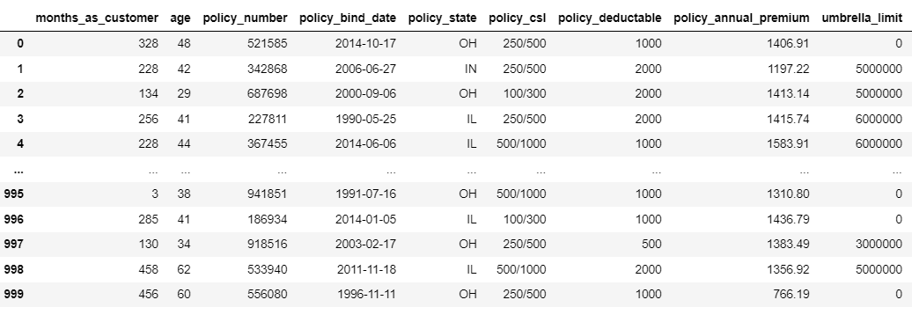
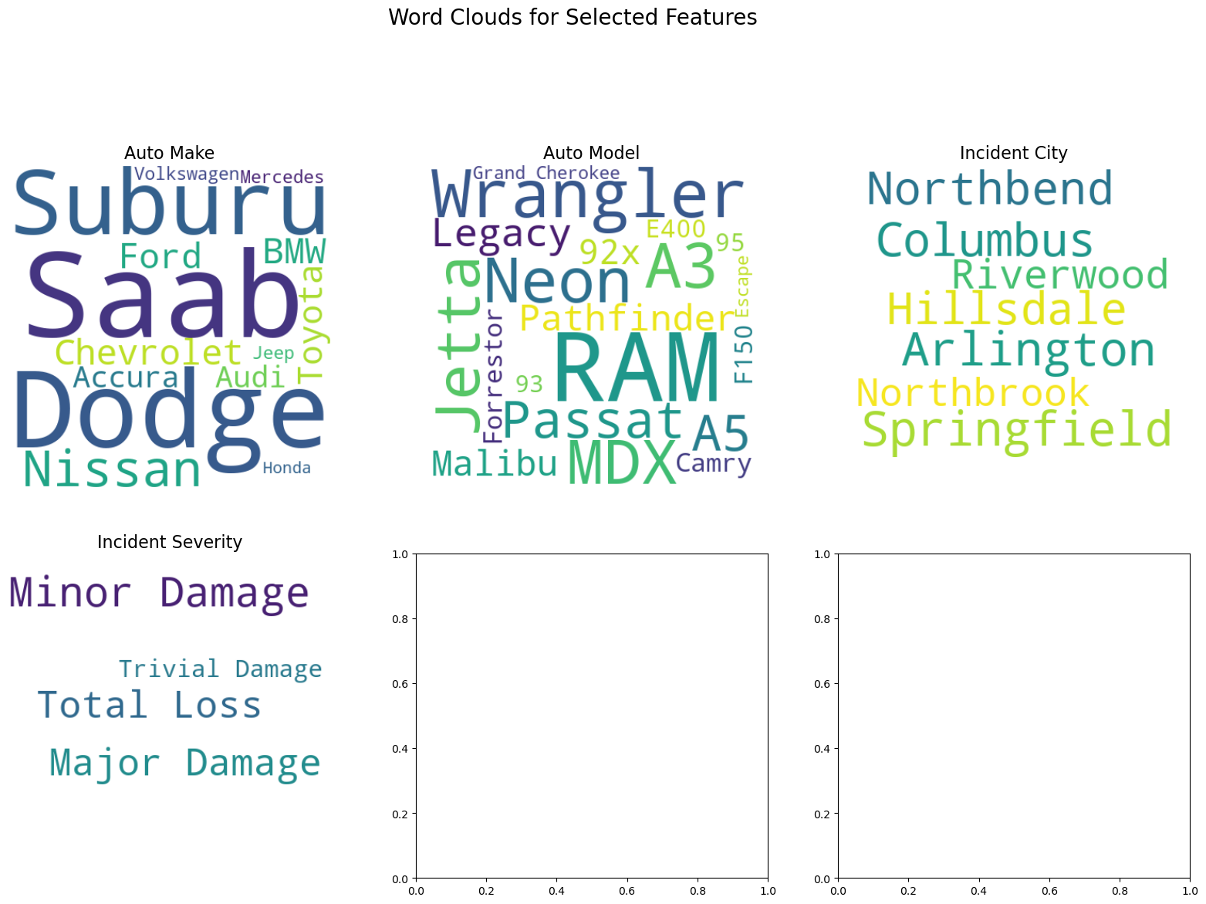
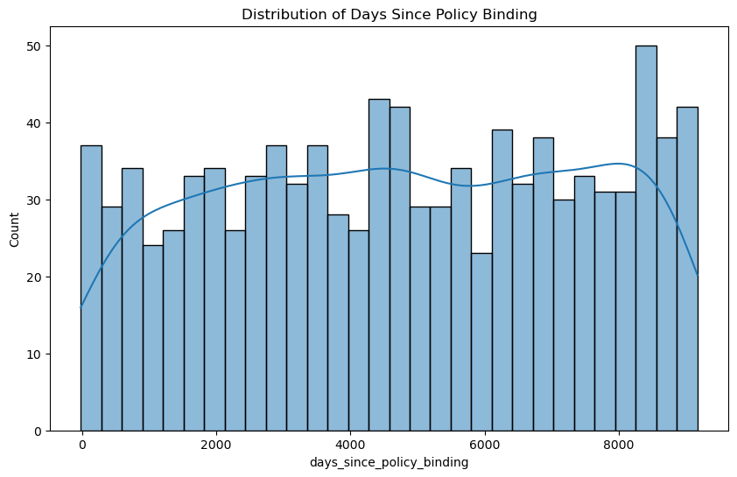
PROJECT LANDSCAPE
DATA
INFORMATION
KNOWLEDGE
Crucial dataset for insurance claim assessment and machine learning.
Mitigated data imbalance using techniques like SMOTE.
Recommendations for enhanced claim resolution.
Critical: Addressing data imbalance with advanced techniques.
Emphasis on continuous model training for evolving fraud detection.
Leveraging AI and ML for precise claim assessment.
Addresses human error, inconsistencies, and biases.
Focus on technology integration and continuous model training.

